Slide 1
Chapter 11
How to create databases, tables, and indexes

Slide 2
Objectives
Applied
Given the design for a database, write the DDL statements to create the tables, constraints, and indexes that are required.
Write a script that includes all of the DDL statements for creating the tables of a database.
Use MySQL Workbench to work with the columns, data, constraints, and indexes for a table.

Slide 3
Objectives (continued)
Knowledge
Describe how each of these types of constraints restricts the values that can be stored in a table: not null, unique, primary key, and foreign key.
Describe the difference between a column-level constraint and a table-level constraint.
Describe the use of an index.
Describe the use of a script for creating the tables of a database.
Describe three character sets that are commonly used with MySQL and the pros and cons of each character set.
Describe how a collation works with a character set.
Describe two storage engines that are commonly used with MySQL and the pros and cons of each engine.

Slide 4
How to use the CREATE DATABASE statement
Syntax
CREATE DATABASE [IF NOT EXISTS] db_name
Create a database named AP
CREATE DATABASE ap
Create a database named AP only if it doesn’t exist
CREATE DATABASE IF NOT EXISTS ap

Slide 5
How to use the DROP DATABASE statement
Syntax
DROP DATABASE [IF EXISTS] db_name
Drop a database named AP
DROP DATABASE ap
Drop a database named AP only if it exists
DROP DATABASE IF EXISTS ap

Slide 6
How to use the USE statement
Syntax
USE db_name
Select a database named AP
USE ap

Slide 7
The syntax of the CREATE TABLE statement
CREATE TABLE [IF NOT EXISTS] [db_name.]table_name
(
column_name_1 data_type [column_attributes]
[, column_name_2 data_type [column_attributes]]...
[, table_level_constraints]
)
Common column attributes
NOT NULL
UNIQUE
DEFAULT default_value
AUTO_INCREMENT

Slide 8
A statement that creates a table without column attributes
CREATE TABLE vendors
(
vendor_id INT,
vendor_name VARCHAR(50)
)
A statement that creates a table with column attributes
CREATE TABLE vendors
(
vendor_id INT NOT NULL UNIQUE AUTO_INCREMENT,
vendor_name VARCHAR(50) NOT NULL UNIQUE
)

Slide 9
Another statement that creates a table with column attributes
CREATE TABLE invoices
(
invoice_id INT NOT NULL UNIQUE,
vendor_id INT NOT NULL,
invoice_number VARCHAR(50) NOT NULL,
invoice_date DATE,
invoice_total DECIMAL(9,2) NOT NULL,
payment_total DECIMAL(9,2) DEFAULT 0
)

Slide 10
The syntax of a column-level primary key constraint
column_name data_type PRIMARY KEY column_attributes
A table with column-level constraints
CREATE TABLE vendors
(
vendor_id INT PRIMARY KEY AUTO_INCREMENT,
vendor_name VARCHAR(50) NOT NULL UNIQUE
)

Slide 11
The syntax of a table-level primary key constraint
[CONSTRAINT [constraint_name]]
PRIMARY KEY (column_name_1[, column_name_2]...)
A table with table-level constraints
CREATE TABLE vendors
(
vendor_id INT AUTO_INCREMENT,
vendor_name VARCHAR(50) NOT NULL,
CONSTRAINT vendors_pk PRIMARY KEY (vendor_id),
CONSTRAINT vendor_name_uq UNIQUE (vendor_name)
)

Slide 12
A table with a two-column primary key constraint
CREATE TABLE invoice_line_items
(
invoice_id INT NOT NULL,
invoice_sequence INT NOT NULL,
line_item_description VARCHAR(100) NOT NULL,
CONSTRAINT line_items_pk
PRIMARY KEY (invoice_id, invoice_sequence)
)

Slide 13
The syntax of a column-level foreign key constraint
[CONSTRAINT] REFERENCES table_name (column_name)
[ON DELETE {CASCADE|SET NULL}]
A table with a column-level foreign key constraint
CREATE TABLE invoices
(
invoice_id INT PRIMARY KEY,
vendor_id INT REFERENCES vendors (vendor_id),
invoice_number VARCHAR(50) NOT NULL UNIQUE
)

Slide 14
The syntax of a table-level foreign key constraint
[CONSTRAINT constraint_name]
FOREIGN KEY (column_name_1[, column_name_2]...)
REFERENCES table_name (column_name_1
[, column_name_2]...)
[ON DELETE {CASCADE|SET NULL}]
A table with a table-level foreign key constraint
CREATE TABLE invoices
(
invoice_id INT PRIMARY KEY,
vendor_id INT NOT NULL,
invoice_number VARCHAR(50) NOT NULL UNIQUE,
CONSTRAINT invoices_fk_vendors
FOREIGN KEY (vendor_id)
REFERENCES vendors (vendor_id)
)

Slide 15
An INSERT statement that fails because a related row doesn’t exist
INSERT INTO invoices
VALUES (1, 1, '1')
The response from the system
Error Code: 1452. Cannot add or update a child row: a foreign key constraint fails ('ex'.'invoices', CONSTRAINT 'invoices_fk_vendors' FOREIGN KEY ('vendor_id') REFERENCES 'vendors' ('vendor_id'))

Slide 16
A constraint that uses the ON DELETE clause
CONSTRAINT invoices_fk_vendors
FOREIGN KEY (vendor_id) REFERENCES vendors (vendor_id)
ON DELETE CASCADE

Slide 17
Terms to know about constraints
Column-level constraint
Table-level constraint
Not null constraint
Unique constraint
Primary key constraint
Foreign key constraint

Slide 18
The syntax for modifying the columns of a table
ALTER TABLE [db_name.]table_name
{
ADD column_name data_type [column_attributes] |
DROP COLUMN column_name |
MODIFY column_name data_type [column_attributes] |
RENAME COLUMN old_column_name TO new_column_name
}

Slide 19
A statement that adds a new column
ALTER TABLE vendors
ADD last_transaction_date DATE
A statement that drops a column
ALTER TABLE vendors
DROP COLUMN last_transaction_date

Slide 20
A statement that changes the length of a column
ALTER TABLE vendors
MODIFY vendor_name VARCHAR(100) NOT NULL
A statement that changes the type of a column
ALTER TABLE vendors
MODIFY vendor_name CHAR(100) NOT NULL
A statement that changes the default value
ALTER TABLE vendors
MODIFY vendor_name VARCHAR(100) NOT NULL
DEFAULT 'New Vendor’
A statement that changes the name of a column
ALTER TABLE vendors
RENAME COLUMN vendor_name TO v_name

Slide 21
A statement that fails because it would lose data
ALTER TABLE vendors
MODIFY v_name VARCHAR(10) NOT NULL
The response from the system
Error Code: 1265. Data truncated for column 'v_name' at row 1

Slide 22
The syntax for modifying the constraints of a table
ALTER TABLE [dbname.]table_name
{
ADD PRIMARY KEY constraint_definition |
ADD [CONSTRAINT constraint_name]
FOREIGN KEY constraint_definition |
DROP PRIMARY KEY |
DROP FOREIGN KEY constraint_name
}

Slide 23
A statement that adds a primary key constraint
ALTER TABLE vendors
ADD PRIMARY KEY (vendor_id)
A statement that adds a foreign key constraint
ALTER TABLE invoices
ADD CONSTRAINT invoices_fk_vendors
FOREIGN KEY (vendor_id) REFERENCES vendors (vendor_id)

Slide 24
A statement that drops a primary key constraint
ALTER TABLE vendors
DROP PRIMARY KEY
A statement that drops a foreign key constraint
ALTER TABLE invoices
DROP FOREIGN KEY invoices_fk_vendors

Slide 25
A statement that renames a table
RENAME TABLE vendors TO vendor
A statement that deletes all data from a table
TRUNCATE TABLE vendor
A statement that deletes a table from the current database
DROP TABLE vendor

Slide 26
A statement that qualifies the table to be deleted
DROP TABLE ex.vendor
A statement that returns an error due to a foreign key reference
DROP TABLE vendors
The response from the system
Error Code: 3730. Cannot drop table 'vendors' referenced by a foreign key constraint 'invoices_fk_vendors' on table 'invoices’
A statement that deletes a table only if it exists
DROP TABLE IF EXISTS vendor

Slide 27
The syntax of the CREATE INDEX statement
CREATE [UNIQUE] INDEX index_name
ON [dbname.]table_name (column_name_1 [ASC|DESC][,
column_name_2 [ASC|DESC]]...)
A statement that creates an index based on a single column
CREATE INDEX invoices_invoice_date_ix
ON invoices (invoice_date)
A statement that creates an index based on two columns
CREATE INDEX invoices_vendor_id_invoice_number_ix
ON invoices (vendor_id, invoice_number)

Slide 28
A statement that creates a unique index
CREATE UNIQUE INDEX vendors_vendor_phone_ix
ON vendors (vendor_phone)
A statement that creates an index that’s sorted in descending order
CREATE INDEX invoices_invoice_total_ix
ON invoices (invoice_total DESC)
A statement that drops an index
DROP INDEX vendors_vendor_phone_ix ON vendors

Slide 29
The script that creates the AP database (part 1)
-- create the database
DROP DATABASE IF EXISTS ap;
CREATE DATABASE ap;
-- select the database
USE ap;
-- create the tables
CREATE TABLE general_ledger_accounts
(
account_number INT PRIMARY KEY,
account_description VARCHAR(50) UNIQUE
);
CREATE TABLE terms
(
terms_id INT PRIMARY KEY
AUTO_INCREMENT,
terms_description VARCHAR(50) NOT NULL,
terms_due_days INT NOT NULL

Slide 30
The script that creates the AP database (part 2)
CREATE TABLE vendors
(
vendor_id INT PRIMARY KEY
AUTO_INCREMENT,
vendor_name VARCHAR(50) NOT NULL
UNIQUE,
vendor_address1 VARCHAR(50),
vendor_address2 VARCHAR(50),
vendor_city VARCHAR(50) NOT NULL,
vendor_state CHAR(2) NOT NULL,
vendor_zip_code VARCHAR(20) NOT NULL,
vendor_phone VARCHAR(50),
vendor_contact_last_name VARCHAR(50),
vendor_contact_first_name VARCHAR(50),
default_terms_id INT NOT NULL,
default_account_number INT NOT NULL,
CONSTRAINT vendors_fk_terms
FOREIGN KEY (default_terms_id)
REFERENCES terms (terms_id),
CONSTRAINT vendors_fk_accounts
FOREIGN KEY (default_account_number)
REFERENCES general_ledger_accounts (account_number)
);

Slide 31
The script that creates the AP database (part 3)
CREATE TABLE invoices
(
invoice_id INT PRIMARY KEY
AUTO_INCREMENT,
vendor_id INT NOT NULL,
invoice_number VARCHAR(50) NOT NULL,
invoice_date DATE NOT NULL,
invoice_total DECIMAL(9,2) NOT NULL,
payment_total DECIMAL(9,2) NOT NULL DEFAULT 0,
credit_total DECIMAL(9,2) NOT NULL DEFAULT 0,
terms_id INT NOT NULL,
invoice_due_date DATE NOT NULL,
payment_date DATE,
CONSTRAINT invoices_fk_vendors
FOREIGN KEY (vendor_id)
REFERENCES vendors (vendor_id),
CONSTRAINT invoices_fk_terms
FOREIGN KEY (terms_id)
REFERENCES terms (terms_id)
);

Slide 32
The script that creates the AP database (part 4)
CREATE TABLE invoice_line_items
(
invoice_id INT NOT NULL,
invoice_sequence INT NOT NULL,
account_number INT NOT NULL,
line_item_amount DECIMAL(9,2) NOT NULL,
line_item_description VARCHAR(100) NOT NULL,
CONSTRAINT line_items_pk
PRIMARY KEY (invoice_id, invoice_sequence),
CONSTRAINT line_items_fk_invoices
FOREIGN KEY (invoice_id)
REFERENCES invoices (invoice_id),
CONSTRAINT line_items_fk_acounts
FOREIGN KEY (account_number)
REFERENCES general_ledger_accounts (account_number)
);
-- create an index
CREATE INDEX invoices_invoice_date_ix
ON invoices (invoice_date DESC);

Slide 33
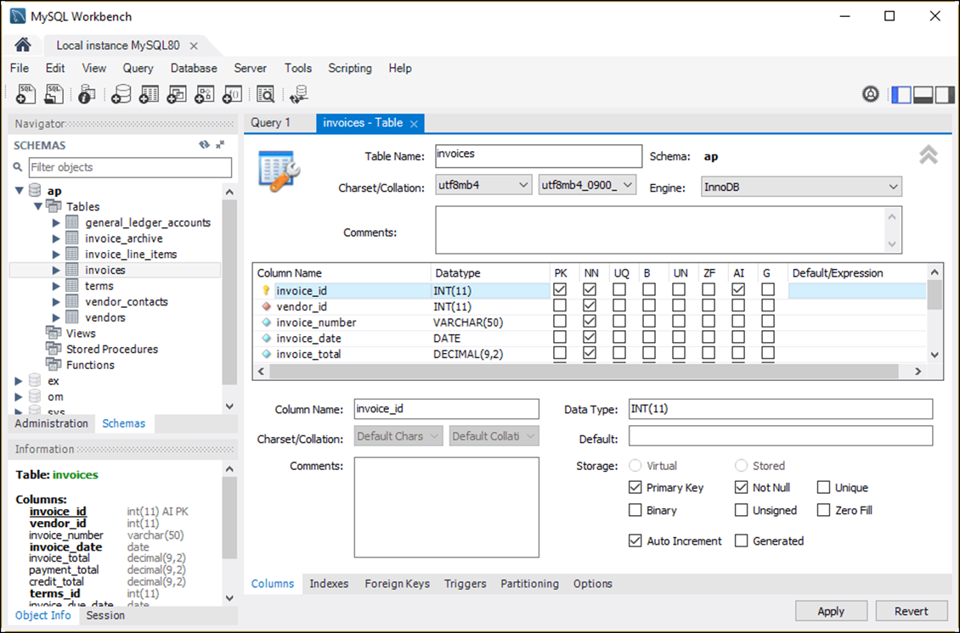
The column definitions for the Invoices table

Slide 34
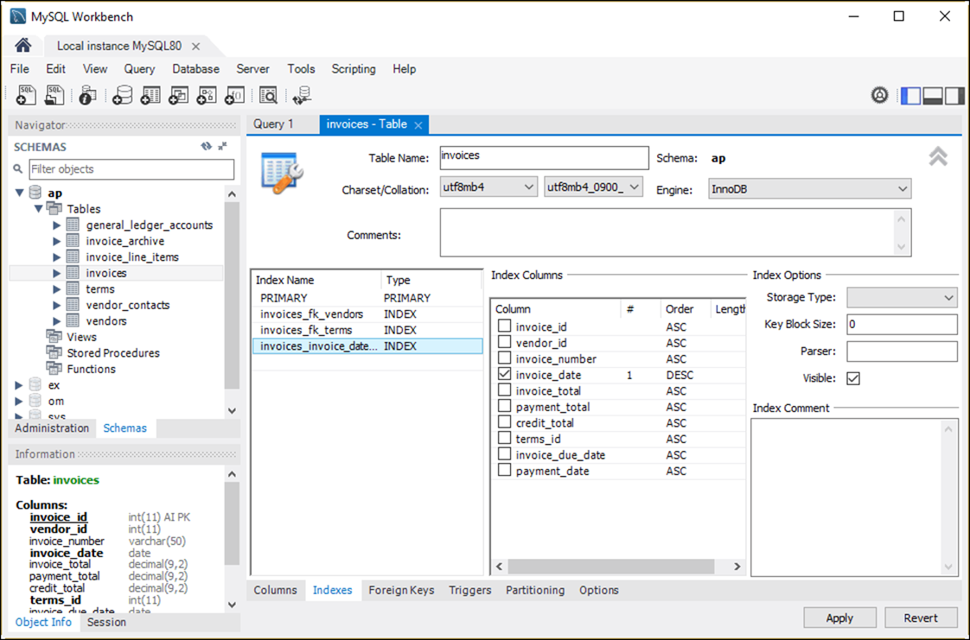
The indexes for the Invoices table

Slide 35
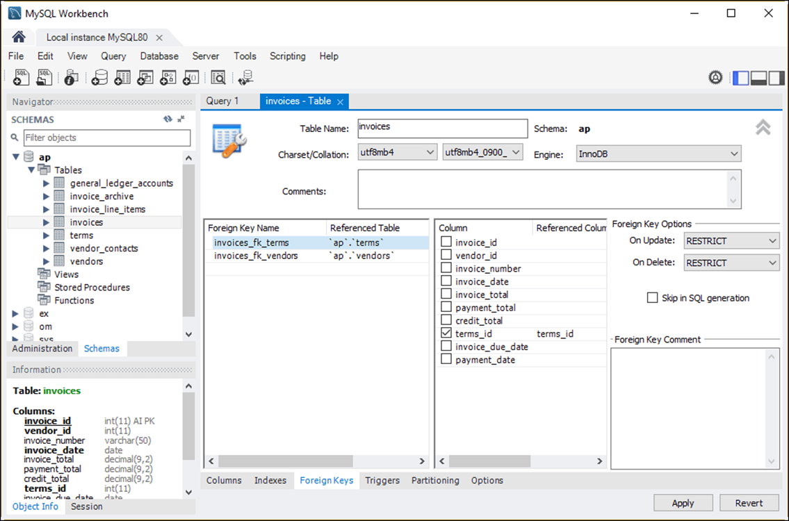
The foreign keys for the Invoices table

Slide 36
Three commonly used character sets
latin1
utf8mb3
utf8mb4

Slide 37
Four collations for the latin1 character set
latin1_swedish_ci
latin1_general_ci
latin1_general_cs
latin1_bin

Slide 38
Four collations for the utf8mb3 character set
utf8_general_ci
utf8_unicode_ci
utf8_spanish_ci
utf8_bin

Slide 39
Three collations for the utf8mb4 character set
utf8mb4_0900_ai_ci
utf8mb4_0900_as_cs
utf8mb4_bin

Slide 40
Collation names
If the name ends with ci, the collation is case-insensitive.
If the name ends with cs, the collation is case-sensitive.
If the name includes ai, the collation is accent-insensitive.
If the name includes as, the collation is accent-sensitive.
If the name ends with bin, the collation is binary.

Slide 41
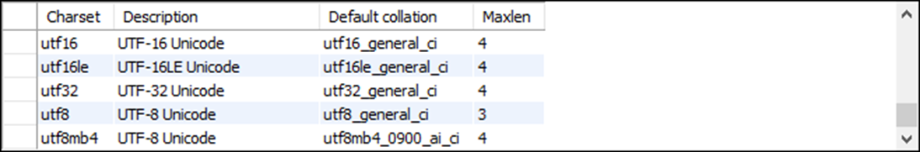
How to view all available character sets for a server
SHOW CHARSET
How to view a specific character set
SHOW CHARSET LIKE 'utf8mb4'

Slide 42
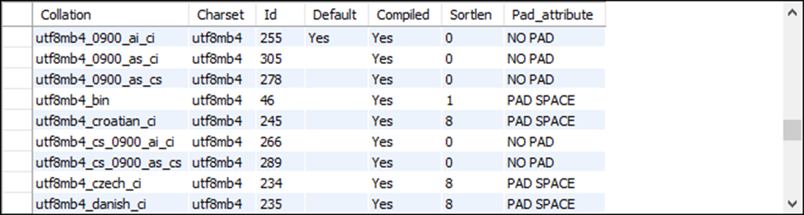
How to view all available collations for a server
SHOW COLLATION
How to view all available collations for a specific character set
SHOW COLLATION LIKE 'utf8mb4%'

Slide 43
How to view the default character set for a server
SHOW VARIABLES LIKE 'character_set_server'
How to view the default collation for a server
SHOW VARIABLES LIKE 'collation_server'
How to view the default character set for a database
SHOW VARIABLES LIKE 'character_set_database'
How to view the default collation for a database
SHOW VARIABLES LIKE 'collation_database'

Slide 44
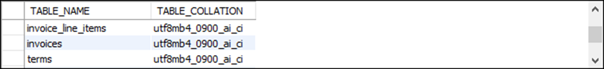
How to view the character set and collation for all the tables in a database
SELECT table_name, table_collation
FROM information_schema.tables
WHERE table_schema = 'ap'

Slide 45
The clauses used to specify a character set and collation
[CHARSET character_set] [COLLATE collation]
How to specify a character set and collation at the database level
For a new database
CREATE DATABASE ar CHARSET latin1 COLLATE latin1_general_ci
For an existing database
ALTER DATABASE ar CHARSET utf8mb4 COLLATE utf8mb4_0900_ai_ci
For an existing database using the CHARSET clause only
ALTER DATABASE ar CHARSET utf8mb4
For an existing database using the COLLATE clause only
ALTER DATABASE ar COLLATE utf8mb4_0900_ai_ci

Slide 46
How to specify a character set and collation at the table level
For a new table
CREATE TABLE employees
(
emp_id INT PRIMARY KEY,
emp_name VARCHAR(25)
)
CHARSET latin1 COLLATE latin1_general_ci
For an existing table
ALTER TABLE employees
CHARSET utf8mb4 COLLATE utf8mb4_0900_ai_ci

Slide 47
How to specify a character set and collation at the column level
For a column in a new table
CREATE TABLE employees
(
emp_id INT PRIMARY KEY,
emp_name VARCHAR(25) CHARSET latin1 COLLATE latin1_general_ci
)
For a column in an existing table
ALTER TABLE employees
MODIFY emp_name VARCHAR(25) CHARSET utf8mb4 COLLATE utf8mb4_0900_ai_ci

Slide 48
Two storage engines provided by MySQL
InnoDB
MyISAM

Slide 49
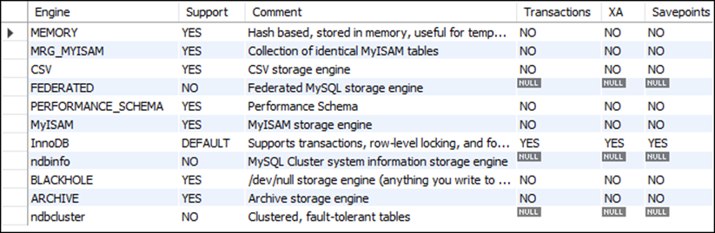
How to view all storage engines for a server
SHOW ENGINES
How to view the default storage engine for a server
SHOW VARIABLES LIKE 'default_storage_engine'

Slide 50
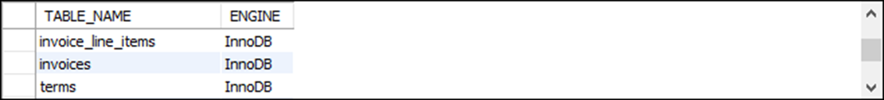
How to view the storage engine for all the tables in a database
SELECT table_name, engine
FROM information_schema.tables
WHERE table_schema = 'ap'

Slide 51
The clause used to specify a storage engine
ENGINE = engine_name
How to specify a storage engine for a table
For a new table
CREATE TABLE product_descriptions
(
product_id INT PRIMARY KEY,
product_description VARCHAR(200)
)
ENGINE = MyISAM
For an existing table
ALTER TABLE product_descriptions ENGINE = InnoDB
How to set the default storage engine for the current session
SET SESSION default_storage_engine = InnoDB

